Slide 1


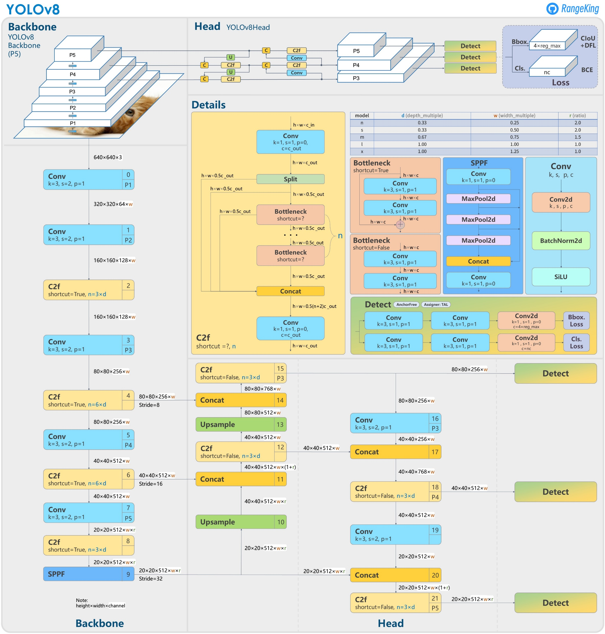
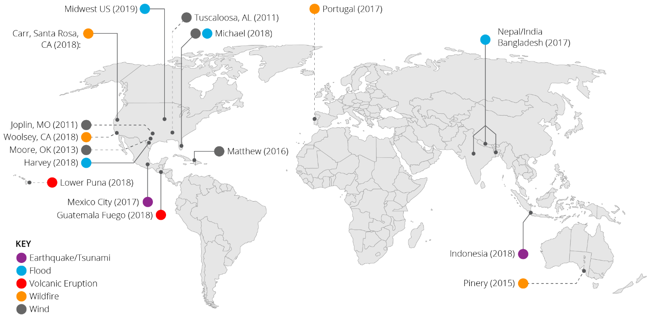
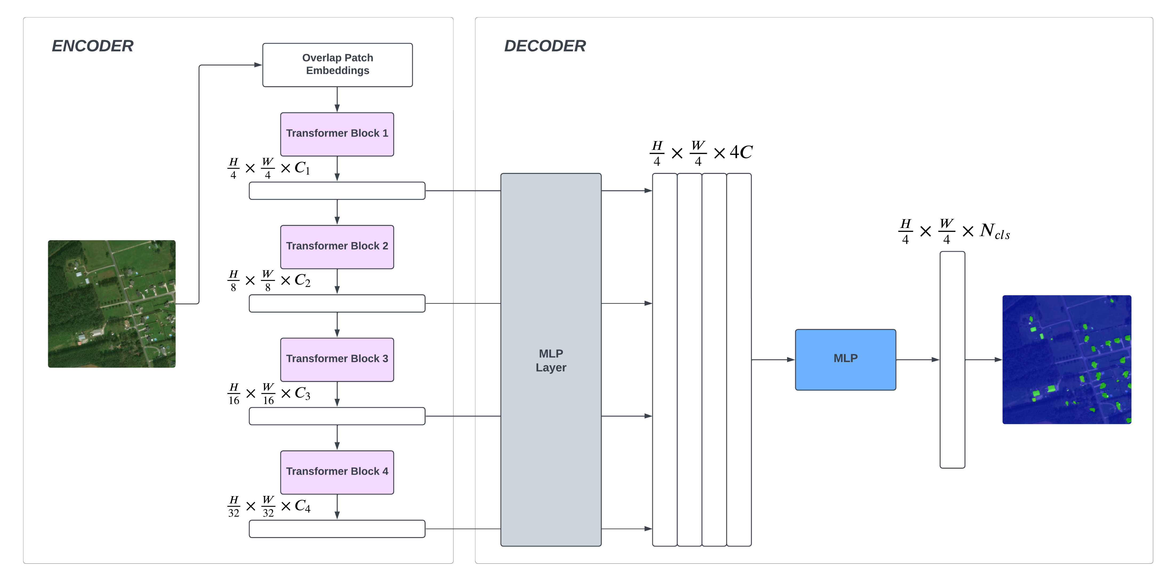
Leveraging Deep Learning to Estimate the Damage Caused by Natural Disasters
Md. Rifat Ahmed, Saifur Rahman Rubayet, Gazi Shoaib
Faculty Advisor: Dr. Shahnewaz Siddique
BACKGROUND
METHODOLOGY
RESULTS
The assessment of building damage caused by natural disasters, is a critical task for emergency response teams, insurance companies, and urban planners. Traditional manual methods are slow, expensive, and prone to errors. Deep learning techniques have emerged as a promising solution, automating building damage estimation with faster and more accurate results
The YOLOv8 model is made of mainly 2 parts, the Backbone and the Head. The backbone has numerous convolution layers that extract distinct features from various levels of resolution from the images. The Head then combines the features acquired from the backbone and predicts the bounding box regions which is the output.
The architecture of the SegFormer model consists of two main modules: A hierarchical Transformer encoder to extract coarse and fine features; and a lightweight All-MLP decoder to directly fuse these multi-level features and predict the semantic segmentation mask. And it doesn’t need positional encoding, thereby avoiding the Interpolation of positional codes which leads to decreased performance when the testing resolution differs from training.
Classifcation Model: YOLOv8x-cls
Precision | Recall | mAP50 | Bbox Loss | Cls Loss
0.530 | 0.312 | 0.333 | 1.676 | 1.210
Segmentation Model: SegFormer-B0
Cross Entropy Loss | IoU (Building) | Mean Accuracy
0.0719 | 0.6845 | 0.6845
DATASET
The xBD (xView Building Damage) dataset is a leading public dataset with high-resolution satellite imagery, fostering research on assessing building damage from natural disasters. Covering six disaster types across fifteen countries, it includes pre- and post-disaster imagery, annotated with polygons and labels for the buildings and bounding boxes for factors like water, smoke, and lava. The Dataset has a total of 22,068 satellite images that spans over 45,362 square kilometers and has 850,736 building crops.
FUTURE DIRECTIONS
The Future Direction of this work is starts from merging both the classification and segmentation model to show the damage classification in the segmented output, using different colors for different damage types.
Then the models used for this study could be further fine-tuned to get better results and accuracy. Trying out newer or deeper variants of other models is also another route that could be taken.
Figure 1 – YOLOv8 Architecture
REFERENCES
[1] D. Kim, J. Won, E. Lee, K. R. Park, J. Kim, S. Park, H. Yang, and M. Cha, "Disaster assessment using computer vision and satellite imagery: Applications in detecting water-related building damages," Frontiers in Environmental Science, Korea, vol. 10, 2022.
[2] S. N. K. B. Amit and Y. Aoki, "Disaster detection from aerial imagery with convolutional neural network," International Electronics Symposium on Knowledge Creation and Intelligent Computing (IESKCIC), Surabaya, Indonesia, pp. 239–245, 2017.
[3] F. Zhao and C. Zhang, "Building Damage Evaluation from Satellite Imagery using Deep Learning," IEEE 21st International Conference on Information Reuse and Integration for Data Science (IRI), Las Vegas, NV, USA, pp. 82–89, 2020.
[4] R. Gupta, R. Hosfelt, S. Sajeev, N. Patel, B. Goodman, J. Doshi, E. Heim, H. Choset, and M. Gaston, “xBD: A Dataset for Assessing Building Damage from Satellite Imagery,” arXiv:1911.09296 [cs.CV], 2019.
[5] G. Jocher, “Ultralytics YOLOv8 Docs,” Ultralytics, https://docs.ultralytics.com (accessed Nov. 11, 2023).
[6] E. Xie, W. Wang, Z. Yu, A. Anandkumar, J. M. Alvarez and P. Luo, “SegFormer: Simple and Efficient Design for Semantic Segmentation with Transformers,” arXiv preprint arxiv.org:2105.15203 [cs.CV], 2021.
RELATED WORKS
Kim et al. used a ResNet-18-based binary model in their study, achieving 85.9% accuracy in identifying structural damages, maintaining 80.3% in non-domain conditions. [1]
In [2], Amit and Aoki proposed a disaster detection model using AlexNet, achieving an accuracy of 80–90% for landslides and floods in Thailand and Japan.
Zhao and Zhang implemented a Siamese-based semantic segmentation model and achieved a harmonic mean of 0.5732 of the F1 scores of the four damage classes. [3]
Figure 2 – SegFormer Architecture
Yolo works best with rectangle shaped objects and its predictions are rectangle too. Thus to get better accuracy, the polygon shaped objects provided into the Dataset had to be converted into bounding boxes of rectangle shapes. Then for segmentation the SegFormer model was wrapped using LoRA (Low Rank Adaptation) to make it easier to train the huge xBD dataset. What LoRA does is that, it adds low-rank "update matrices" to the attention blocks in the underlying SegFormer model to accelerate the training of the model while consuming less memory.

